Slide 1

Project Deck: IEOR 4578: Forecasting: A Real-World Application Prof. Syed Haider Electricity Load Data Project Final Deliverable
by:
Ishita Pundir (ip2441)
Saumya Kothari (sbk2171)
Tushar Bura (tb3077)

Slide 2



Agenda
Introduction
Modifications and Process Flow
Business Problem Definition, Value Creation and Need for forecasting analysis
Process Flow/Timeline
Data Extraction
Data Processing
Target Variables & Predictive Variables
Pre-Modelling
Analysis
Exploratory Data Analysis
Time Series Analysis
Modelling -
ARIMA
SARIMA
Facebook Prophet
TFT
Random Forest Regressor
Model Selection
Future Scope
Team Information

Slide 3




Introduction
This project leverages machine learning and statistical techniques to enhance electricity consumption forecasting. By analyzing the UCI Machine Learning Repository: Electricity Load Diagrams 2011-2014 dataset, which includes detailed consumption data from 370 clients over four years, we aim to develop predictive models capable of accurately forecasting future electricity loads. These models will help energy providers optimize resources, improve infrastructure investments, and boost operational efficiency.

Slide 4
Recommendation of Model
Through a final evaluation we recommend the: Random Forest Regressor
We will see how later in the report and slide deck, according to evaluation metrics, it provides the best result. It also provides advantages such as:
Robustness to Overfitting: Random Forest is naturally resistant to overfitting due to its ensemble approach, which involves averaging multiple decision trees.
Handling Non-linear Relationships: Random Forest can effectively model complex, non-linear relationships in data, making it suitable for diverse datasets.
Feature Importance: Random Forest provides insights into which features most significantly impact predictions, aiding in better understanding and optimization of the model.
We also notice that the Temporal Fusion Transformer (TFT) performs very well, and can be used on other types of datasets and results can be compared. It provides benefits such as:
Temporal Patterns: TFT excels in capturing complex temporal relationships and patterns, leveraging past data points and contextual information.
Multivariate Capabilities: TFT can handle multiple input features and output variables, making it ideal for scenarios where multiple related forecasts are needed simultaneously.
Flexibility and Adaptability: TFT can incorporate static and known future inputs, enhancing its forecasting accuracy and adaptability to different forecasting scenarios.

Slide 5
Previous
New
Business Problem Definition
Business Problem Definition
This project addresses the key business challenge of accurately forecasting sales for seasonal retail items. It involves predicting sales volume, understanding customer behavior, and managing inventory efficiently to balance demand.
Electricity stands as a fundamental pillar in modern society, driving progress and daily operations across the globe. Recognizing its critical role, our objective is to refine our understanding and management of electricity consumption through precise forecasting of future demand. By employing advanced analytical techniques, this project seeks not only to predict but also to optimize the distribution and utilization of electrical energy, ensuring sustainability and efficiency in its delivery to meet evolving needs.
Objective
Objective
The purpose of this project is to analyze historical data on the amount of electricity usage to identify patterns that can help predict future consumption, with the underlying assumption that these patterns will remain consistent in the future.
The objective of this project is to delve into historical electricity usage data, employing advanced machine learning techniques like TFT. This analysis goes beyond traditional pattern recognition, challenging the assumption of consistent future behavior by incorporating factors like seasonality, and Portugal's holiday pattern. Our goal is to construct dynamic predictive models that adapt to these evolving variables, providing more accurate and resilient forecasts for future electricity consumption.

Slide 6
Previous
Cost Reduction for Utilities
Energy Efficiency and Policy Making
Investment and Infrastructure Planning
Value Creation
New
Sustainability and Regulatory Compliance:
Our analysis helps in identifying optimal strategies for energy conservation and efficiency. By predicting peak demand times and suggesting suitable demand-response strategies, the utility companies can not only comply with regulatory standards but also promote sustainable energy use among consumers.
Adaptive Infrastructure Development:
By providing detailed insights into future consumption trends, our models assist in strategic planning and investment in infrastructure. This adaptive approach ensures that resources are allocated effectively to meet changing demands, thereby optimizing capital expenditure and supporting long-term economic viability.
Value Creation
Enhanced Predictive Accuracy:
By integrating sophisticated machine learning models that factor in external variables such as weather patterns, economic shifts, and technological growth, our project enhances the accuracy of electricity consumption forecasts. This not only improves operational decisions but also reduces financial risks associated with demand forecasting errors.

Slide 7
Architecture
Data Preprocessing: Initial data cleansing removed inaccuracies or irrelevant information, while 'Time' column conversions and data aggregation facilitated analysis through simplified granularity.
Analysis: Clustering and advanced curve fitting techniques like Cubic Splines and Piecewise Linear fits were employed to identify and visualize patterns in electricity usage.
Exploratory Data Analysis (EDA): Tableau was integrated to create interactive dashboards, enhancing the visualization of complex data sets and aiding in the identification of significant trends and patterns.
Feature Engineering: Data transformation processes were applied to derive meaningful attributes critical for the effectiveness of our forecasting models.
Model Development: We implemented advanced time-series analysis techniques, enhancing traditional models with the inclusion of TFT and Random Forest to capture both trends and seasonality effectively.
Model Evaluation: Model efficacy was assessed using the Mean Absolute Percentage Error (MAPE), comparing our predictions for 2014's electricity usage with the actual data.
Presentation and Reporting Layer: The results are meticulously documented and presented, ensuring clarity and comprehensive understanding for all stakeholders.
Monitoring and Maintenance Layer: Continuous monitoring is established to maintain the accuracy and relevance of the models over time..

Slide 8
TIMELINE
Data Collection & Preprocessing
Gathered electricity usage data from the UCI Machine Learning Repository and conducted initial cleansing to remove inaccuracies. Data was converted for easier manipulation and aggregated to daily consumption levels for simplicity.
Exploratory Data Analysis
Utilized Tableau for creating detailed visualizations to identify underlying patterns, trends, and outliers in the electricity consumption data. This step helped in understanding the dataset's structure and key variables influencing electricity usage.
Feature Engineering
Transformed the cleaned data to extract and create new meaningful features that could significantly impact the predictive models. This involved selecting, modifying, or combining existing data attributes.
Evaluated the models using MAPE to measure their accuracy against actual 2014 electricity usage data. Adjustments and refinements were made based on performance to optimize the predictions.
Model Development & Training
Developed multiple forecasting models using techniques like ARIMA, SARIMA, Facebook Prophet, TFT, and Random Forest. Models were trained with the newly engineered features and clusters identified from the data.
Evaluation & Refinement

Slide 9
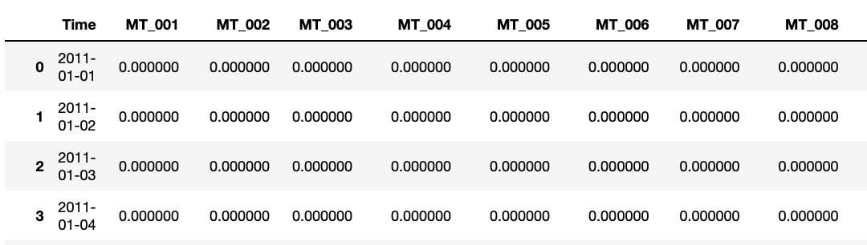
Data Overview
Source: https://archive.ics.uci.edu/dataset/321/electricityloaddiagrams20112014
Introduction:
The data set contains electricity consumption of 370 points/clients. Each column represent one client. Collected from 2011 to 2014.
The values are in kW of each 15 min and no missing values. All days present 96 measures (24*4). Every year in March time change day (which has only 23 hours) the values between 1:00 am and 2:00 am are zero for all points. Every year in October time change day (which has 25 hours) the values between 1:00 am and 2:00 am aggregate the consumption of two hours.
Variable Information:
Data set were saved as txt using csv format, using semicolon (;).
The First column present date and time as a string with the following format 'yyyy-mm-dd hh:mm:ss’
Other columns present float values with consumption in kW

Slide 10
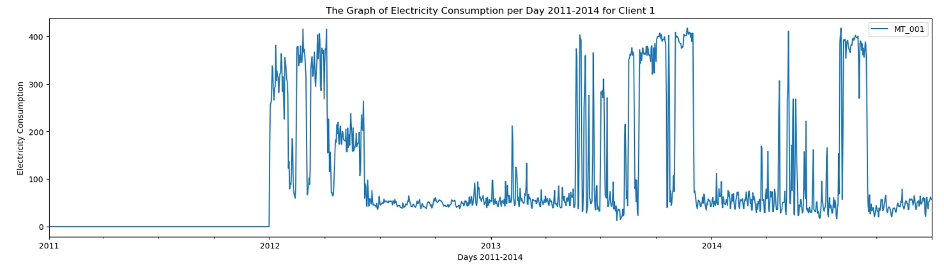
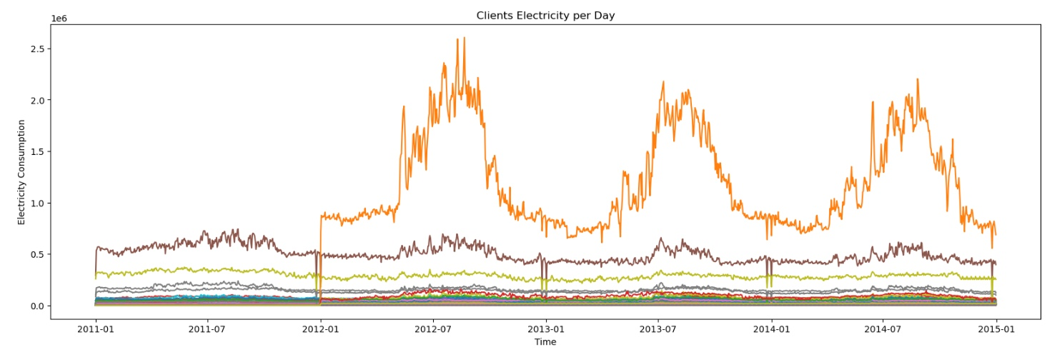
Visualization
We can see the overall electricity load of Client 1 through this graph in kWh.
We see the load consumption of all the 370 customers on one graph as shown in kWh.

Slide 11
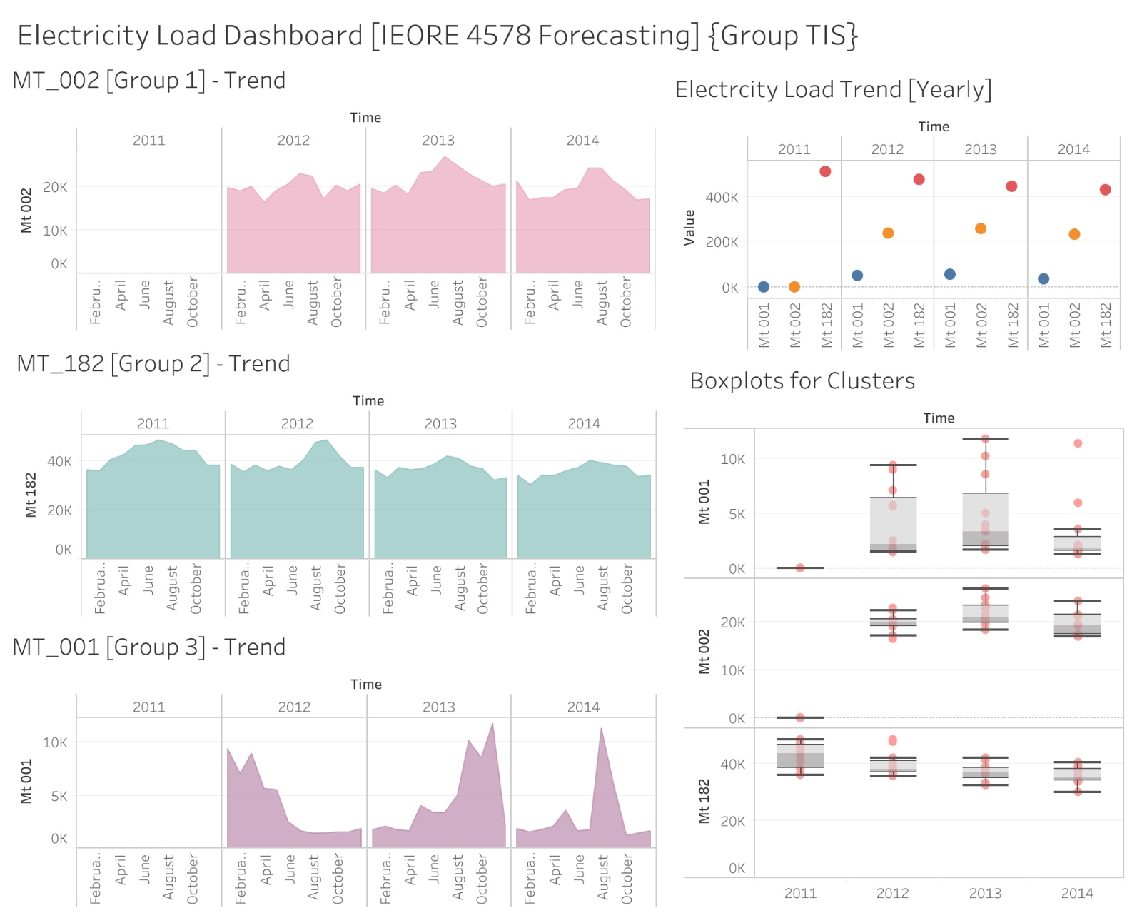
The "Electricity Load Dashboard" efficiently visualizes electricity consumption trends and variability across three client groups from 2011 to 2014. (Tableau file attached to submission)
Dashboard Adding on to the previous group, we also created a dashboard in Tableau as follows:

Slide 12
Data Preprocessing
Data Format:
Replace the comma as decimal point;
Convert the string value to float;
Convert the unit from KW/15 min to daily electricity consumption;
Dataset Diagnostics:
158 clients have created account since 2011; 162 clients create account from 2011 to 2012; 50 clients create account after 2012;
We cluster customers together and then predict their electricity load consumption;
Data Clustering:
Clustering (K-means) the similar time series into 3 clusters, groups 1, 2 and 3. Select representatives MT_002, MT_182 and MT_001 for models fitting;

Slide 13
Modelling Data Creation
Previously done:
For each of the customers, the modeling data are collected and processed using the following steps. The below also addresses the feature engineering section.
Replace comma to decimal and convert values stored from string to float.
Aggregate electricity consumption to change the record of every 15 minutes to every day, and convert units from kW to kWh by dividing current values by 4.
Since 158 clients have created accounts since 2011, 162 clients created accounts from 2011 to 2012, and 50 clients created accounts after 2012, we select clients joined in 2011 as representatives and use their data to train and test models.
Additional Data Handling:
Take care of the change of time date as needed for different models.
Pay attention to time related features such as year (2011, 2012, 2013, 2014), quarter (1-4), month (1-12), weekday (0-6), day (1-31), hour (0-23) as needed for different models.
Consider holidays based on Portugal's official holidays, since dataset is from Portugal
Identify client groups based on the their similarity (more in modeling part)

Slide 14
Target and Predictive Variables
Target Variable: Electricity Load Consumption (2014-15)
The target variable, or dependent variable, for our project is the daily electricity load consumption in kWh for 2014-15. Chosen for its direct relevance to energy usage patterns, it aids in operational planning and efficiency optimization by highlighting consumption trends and peak demand periods. Accurate forecasting of this variable is crucial for managing energy supply, enhancing cost-efficiency, and minimizing the environmental impact of energy production.
Predictive Variables: Prior Electricity Load Consumption (2011, 2012, 2013)
The addition we have made is as follows: Predictive variables are utilized to estimate the target variable. In our analysis, these are divided into:
Direct Variables: Sourced directly from the dataset, such as clients' electricity consumption in kWh for the years 2011, 2012, and 2013.
Derived Variables: Developed by manipulating direct variables, these include time-related features like year, quarter, month, weekday vs. weekend, day, and hour. Additionally, the Facebook Prophet model uses holidays as an extra derived variable.

Slide 15
Pre-Modelling (Clustering)
Pre-modeling Enhancements
Expanded from two to three clusters based on additional analysis.
Three-cluster model achieved a superior silhouette score, indicating more nuanced variations in client consumption patterns.
Aim: Enhance granularity and accuracy of predictions, improving model efficacy.
Clustering Methodology
Optimized time and memory usage by clustering instead of individual model training for each client.
Applied K-Means clustering to segment 370 client datasets into three distinct groups.
Chose three clusters based on trial and error optimization and silhouette score evaluation.

Slide 16
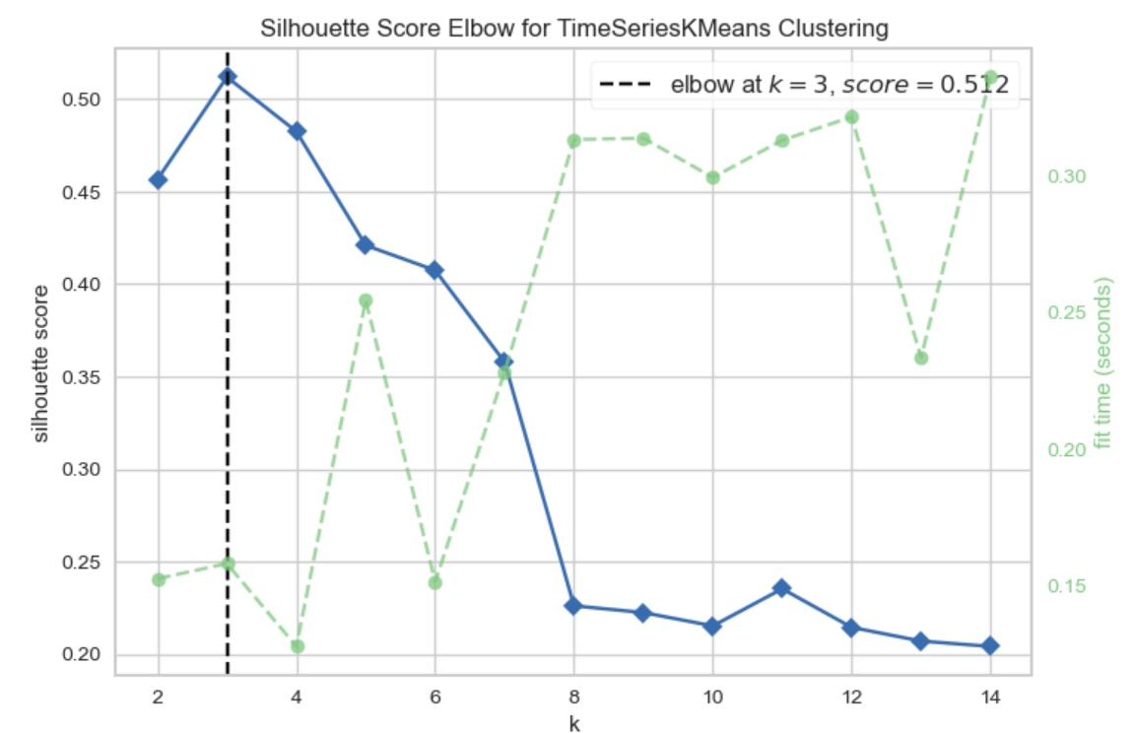
Pre-Modelling (Clustering)
Silhouette Score Evaluation
Used to assess cluster quality; measures similarity within a cluster versus other clusters.
Higher scores indicate well-defined clusters; three clusters provided the highest silhouette score.
Selection of Representative Clients
Selected representative clients from each cluster (MT_002, MT_181, MT_001) based on comprehensive data from 2011-2014.
These clients represent their respective clusters' patterns, aiding in focused analysis and model training.

Slide 17
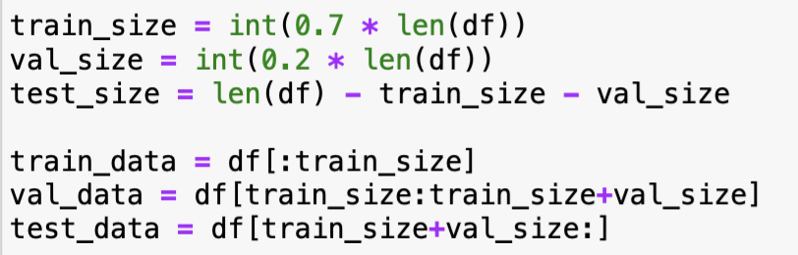
Modelling Methodology
Train, Validation, Test Split: The ratio of split is as follows:
70%: Training Data
20%: Validation Data
10%: Test Data
We have divided the test data into 4 equal parts.
The training set serves as the foundation for training the model, where it learns from the data's patterns and relationships.
Following training, the validation set is employed to fine-tune model parameters and gauge performance, ensuring optimal performance on new data.
Lastly, the test set provides an unbiased evaluation of the model's performance on previously unseen data, confirming its generalization capabilities.
This division enables rigorous assessment and refinement of machine learning models, bolstering their reliability and effectiveness in real-world applications.

Slide 18
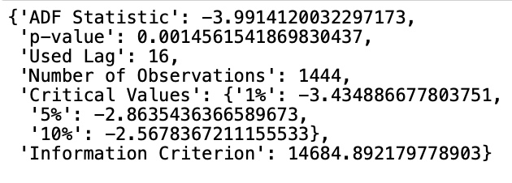
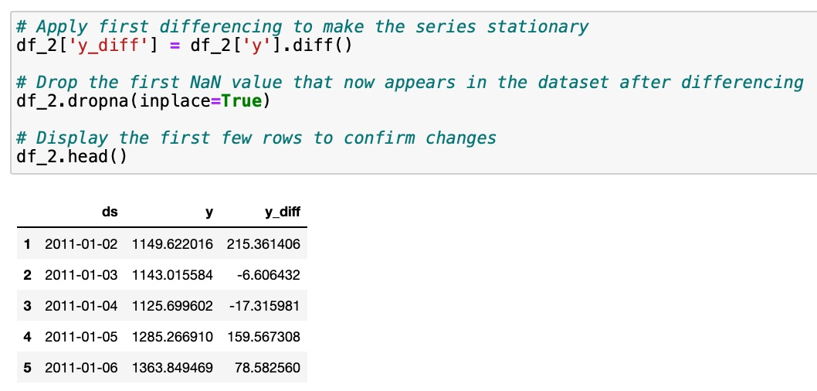
Checking Stationarity
Stationarity Assumption: Stationarity in data refers to constant statistical properties typically including the mean, variance, and autocorrelation structure.
We have used the Augmented Dickey Fuller Test, to check stationarity and made our model stationary. We have run this model on all the 3 data frames.
We observe that df_3 is stationary since it has a large negative value and a p-value < 0.05. We then, through the differencing method, make df_1 and df_2 stationary.

Slide 19
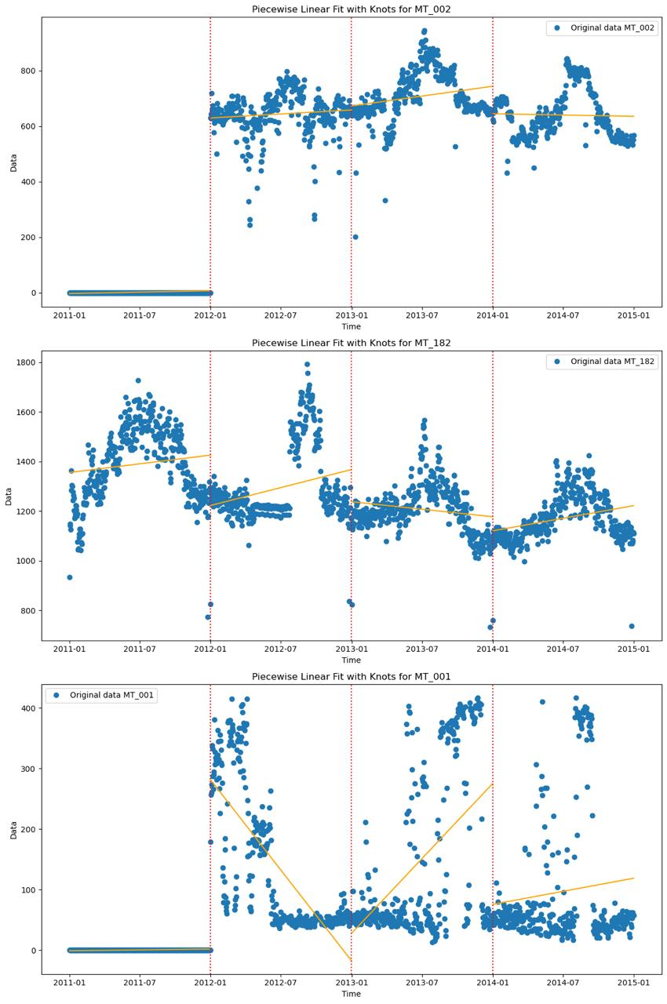
Modelling – Piecewise Linear Fit
MT_002: Consistent consumption with minor fluctuations; flat linear trend indicates stable usage.
MT_182: Variable, increasing consumption trend; linear fit shows a noticeable rise, evaluated annually.
MT_001: High variability with peaks in late 2012 and early 2013; linear trend reveals a sharp rise then stabilization.

Slide 20
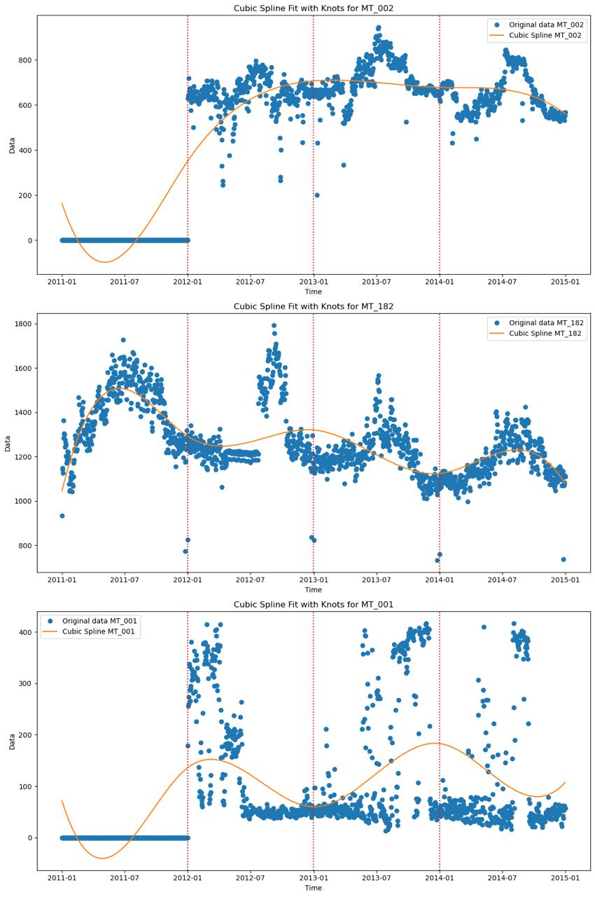
Modelling – Cubic Spline Fit
MT_002: Moderate variability with trends stabilizing post-early 2012 rise.
MT_182: Significant fluctuations, peaking mid-2013 followed by a decline.
MT_001: Generally low consumption with a temporary spike modeled in 2013.

Slide 21
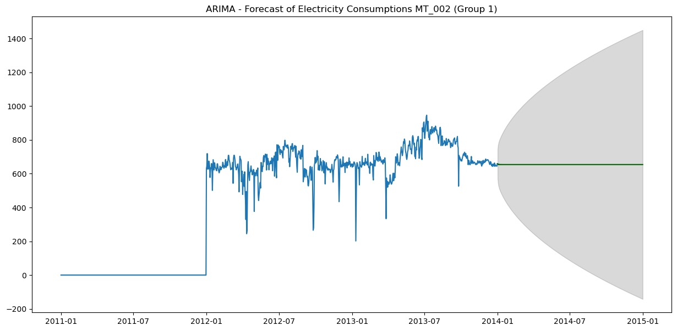
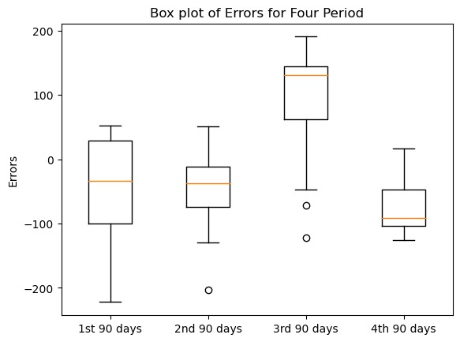
Modelling – ARIMA
Time series forecasting method with autoregression, differencing, and moving average components.
Incorporated day index as exogenous variable to capture daily patterns.
Achieved Total MAPE of 11.94% on test dataset.
Reasonable performance for Clusters1and 2. But Poor performance for Cluster 3

Slide 22
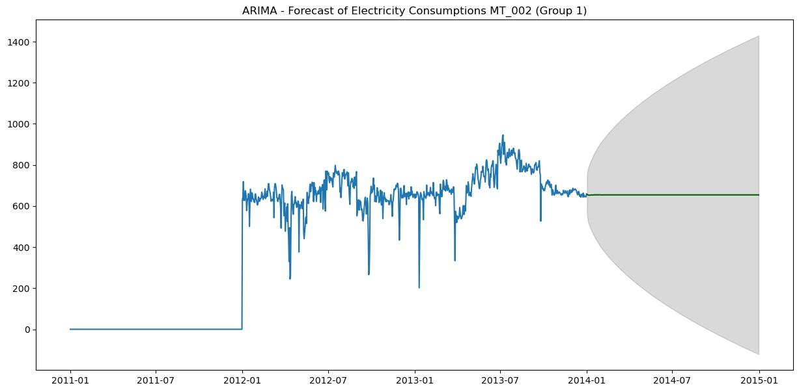

Modelling – SARIMA
SARIMA extends ARIMA to incorporate seasonal patterns.
Utilized auto_arima function for parameter selection, minimizing AIC.
Achieved Total MAPE of 11.96% on the test dataset for Cluster 1 (MT_002).
Poor performance for Cluster 3 (MT_001) with a high MAPE of 91.63%.

Slide 23
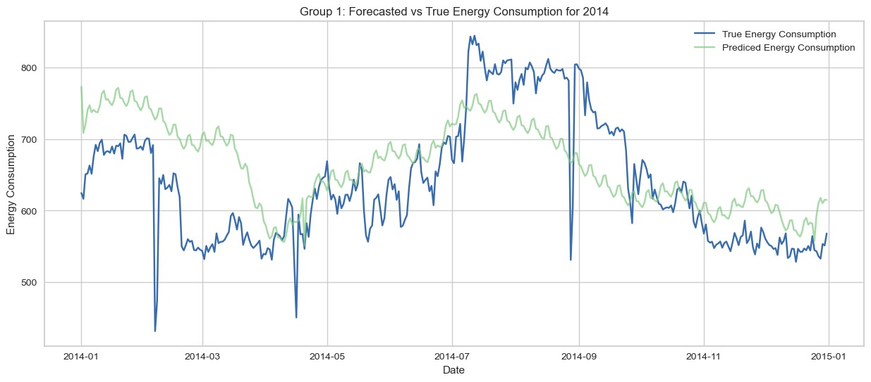
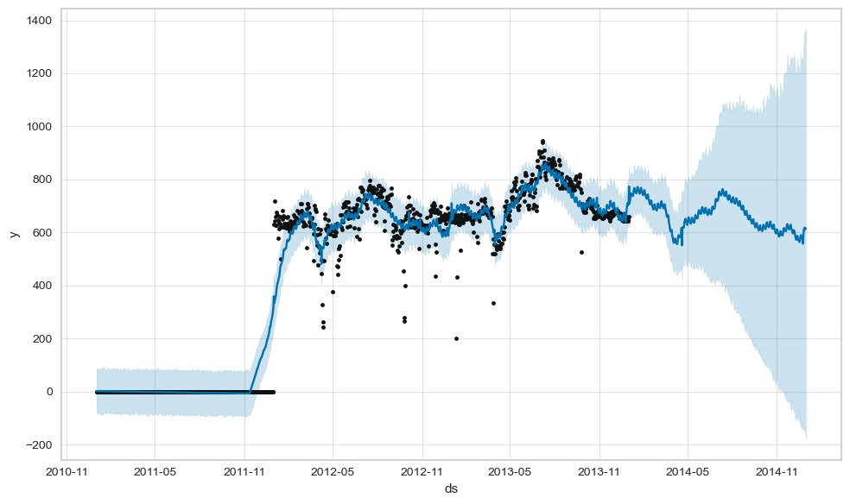
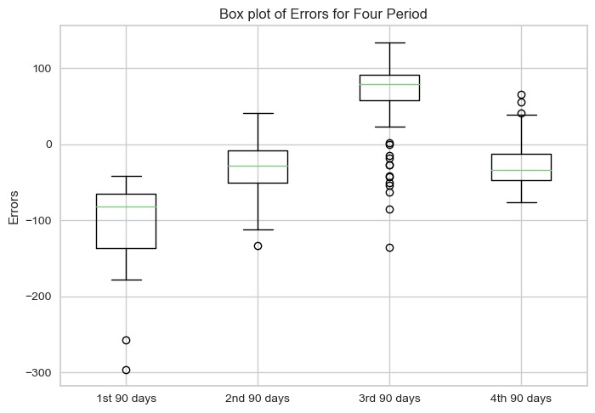
Modelling – Facebook Prophet
Facebook Prophet handles time-series data with strong seasonal patterns, outliers, and missing data.
Grid search for hyperparameter tuning
Achieved MAPE ~ 9.8% for Group 1 (Cluster 0) and ~3.0% to ~9.2% for Group 2 (Cluster 1), indicating reasonable performance.
Group 3 exhibited higher MAPE values, suggesting poorer forecasting accuracy and potential issues.

Slide 24
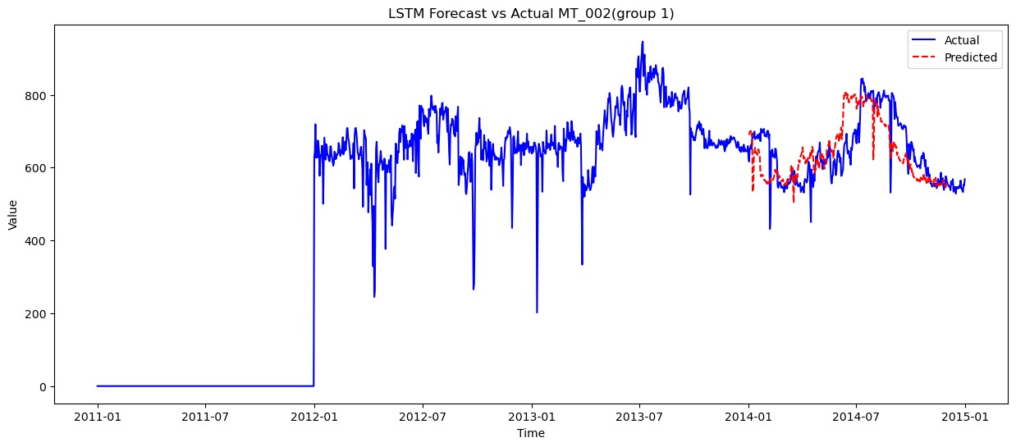
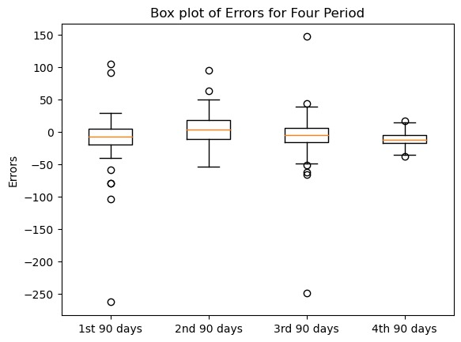
Modelling – Temporal Fusion Transformers (TFT)
TFT combines attention mechanisms with gated linear units to capture temporal patterns efficiently.
Achieved low MAPE value of approximately 3.08%, indicating high forecasting accuracy.
Demonstrated consistency in performance across different time periods, highlighting robustness to temporal variations.
TFT's interpretability may be limited due to its deep learning nature

Slide 25
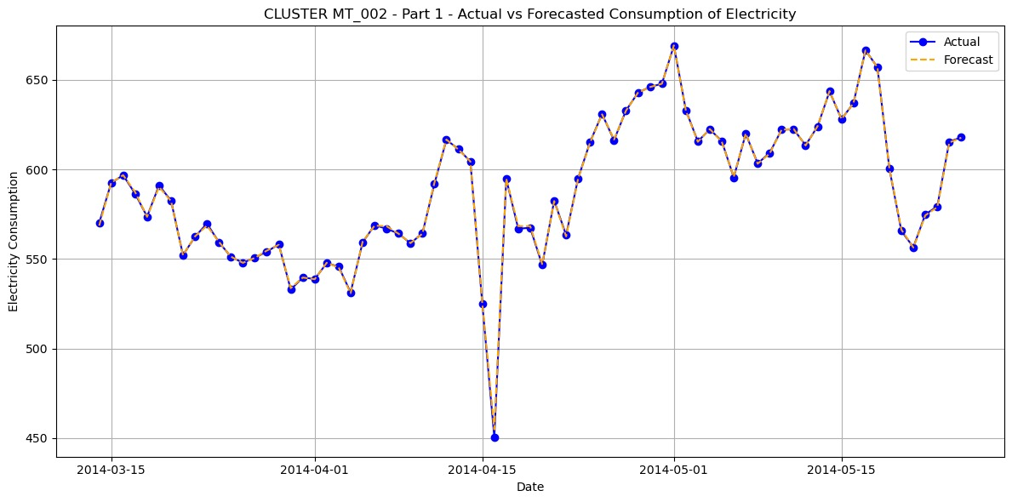
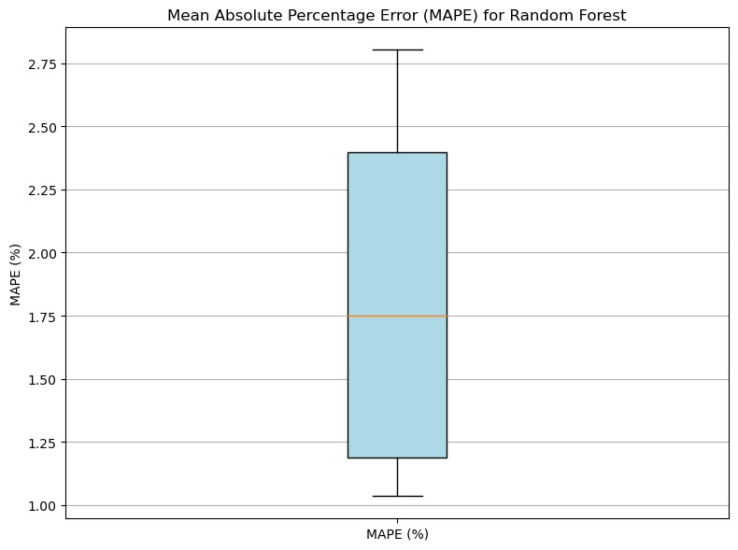
Modelling – Random Forest Regressor
Random Forest Regressor handles complex nonlinear relationships common in time-dependent data.
Utilizes lagged variables as predictors to capture temporal dependencies.
Achieved low MAPE ranging from 0.51% to 5.19% for Cluster MT_182, indicating accurate forecasts with minor deviations.
Cluster MT_001 exhibited higher variability in performance, suggesting potential sensitivity to data characteristics or the need for further tuning.

Slide 26
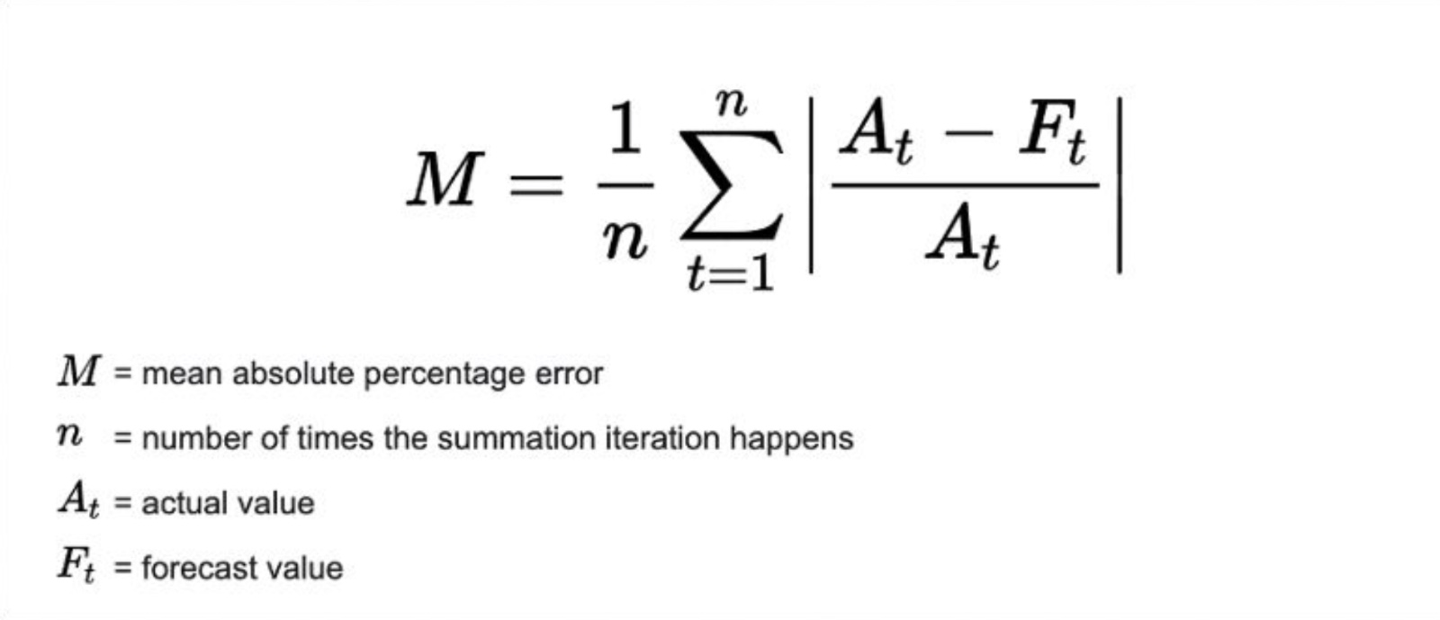
Evaluation Matrix
Mean Absolute Percentage Error (MAPE) is obtained as the mean absolute percentage error function for the prediction and the eventual outcomes.
Preference of MAPE: As MAPE is a relative measure, it allows for the comparison of forecasts across different scales or units of measurement. MAPE expresses errors as a percentage, making it easier for business stakeholders to understand the magnitude of forecasting errors relative to actual values.

Slide 27
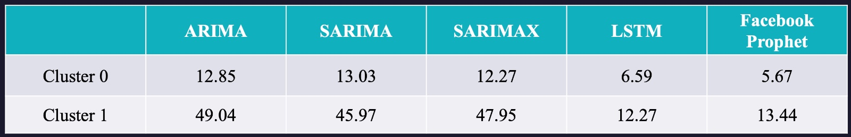
Previously calculated Comparative Analysis
Previously, we can see there are only 2 clusters which categorize the data in a non-statistically proven method, therefore, values of MAPE may be slightly skewed:
We categorize the clusters according to K-Means using the silhouette score, and the results are displayed on the following slide.

Slide 28
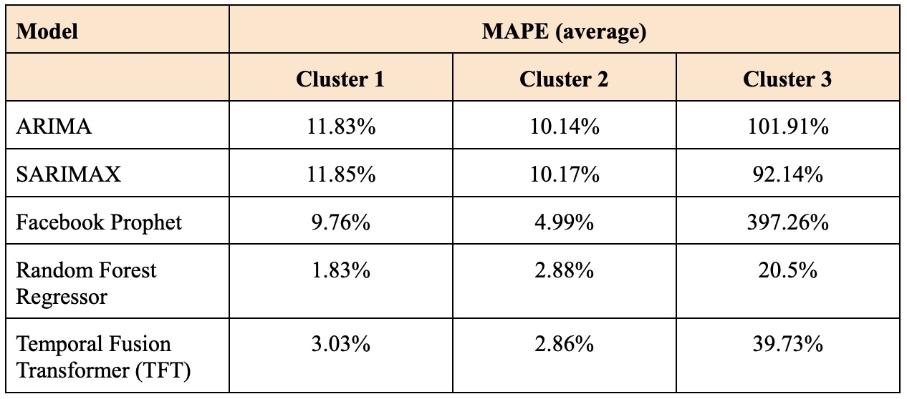
Comparative Analysis for Forecasting Models
We can see that, overall, Random Forest Regressor performs the best on the three clusters we have chosen. We also see the Temporal Fusion Transformer (TFT) to perform very well, indicating potential for further analysis to get deeper insights.
Benefits:
Handling Non-linear Relationships: Random Forest can effectively model complex, non-linear relationships in data, making it suitable for diverse datasets.
Temporal Patterns: TFT excels in capturing complex temporal relationships and patterns, leveraging past data points and contextual information.

Slide 29
Future Scope and Creation of Value
Granular Forecasting: Deep dive into individual client consumption patterns to enable targeted energy efficiency strategies and tailored billing models.
Data Enrichment and Continuous Retraining: Integrate external data like weather and economic indicators for enhanced accuracy and retrain models with new data to keep forecasts current and relevant.
Advanced Modeling Techniques: Employ deep learning models like RNNs for complex time-series analysis, and explore hybrid and ensemble models to increase robustness and accuracy.
Cross-Sector Application: Extend the modeling framework to other utility sectors and industries, such as manufacturing and hospitality, for broader consumption forecasting.
Technological and Data Infrastructure: Develop real-time data processing capabilities and utilize big data technologies and cloud computing for efficient, large-scale data analysis.

Slide 30



TEAM
Ishita Pundir
Saum Kothari
Tushar Bura
ip2441
sbk2171
tb3077

